Slide 1

Flick Stick
An Android Mobile Soccer Game
Anthony Menjivar
January 21, 2015

Slide 2
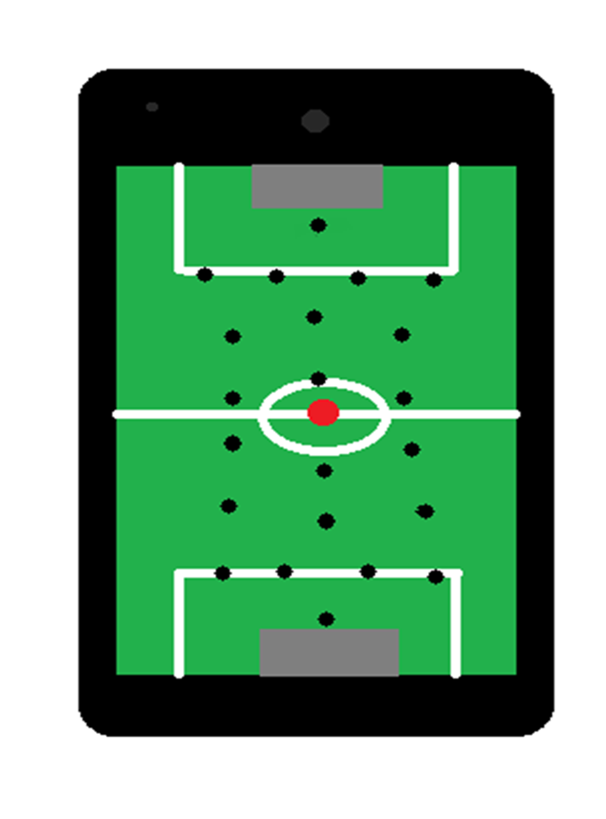
Flick Stick Description
Layout
Soccer Field
22 sticks (11 on each side)
Pre-Determined Formation
Obstacles

Slide 3
Flick Stick Description
Game Play
2 players (1v1, 1vRobot, 1vOnline)
1st player flicks ball from starting point towards goal to score
Players take turns flicking the ball
First to certain amount of goals wins
Audience
Anyone that knows how to use a phone or tablet and can play games

Slide 4
Justification

Slide 5
User’s View

